Slide 1
crypto++

Slide 2
Install crypto++
sudo apt-get update
sudo apt-get install libcrypto++-dev libcrypto++-doc libcrypto++-utils
Include in CmakeLists.txt (hard way)
cmake_minimum_required(VERSION 3.5)
project(Demo)
# Specify the include and library directories for Crypto++
include_directories(usr/include/crypto++)
link_directories(usr/lib/x86_64-linux-gnu)
# Add your executable and link with Crypto++ library
add_executable(myExecutable main.cpp)
target_link_libraries(myExecutable crypto++)

Slide 3
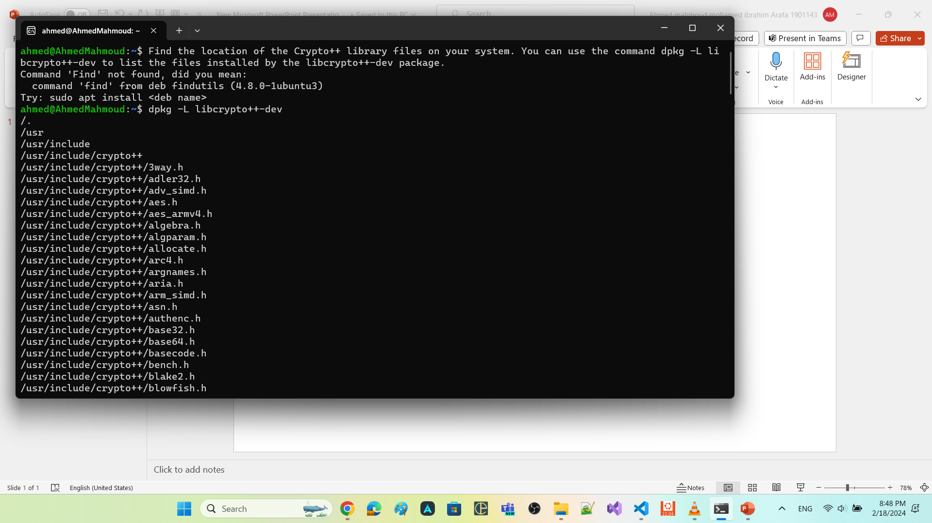

dpkg -L libcrypto++-dev

Slide 4
Include in CmakeLists.txt (soft way)
Create a FindCrypto++.cmake file with the following content:
find_path(Crypto++_INCLUDE_DIR cryptopp)
find_library(Crypto++_LIBRARY NAMES cryptopp)
set(Crypto++_FOUND TRUE)
if(NOT Crypto++_LIBRARY OR NOT Crypto++_INCLUDE_DIR)
set(Crypto++_FOUND FALSE)
endif()
if(Crypto++_FOUND)
set(Crypto++_LIBRARIES ${Crypto++_LIBRARY})
set(Crypto++_INCLUDE_DIRS ${Crypto++_INCLUDE_DIR})
endif()

Slide 5
Update your CMakeLists.txt file with the following content:
cmake_minimum_required(VERSION 3.5)
project(Demo)
# Include the directory containing FindCrypto++.cmake
set(CMAKE_MODULE_PATH ${CMAKE_MODULE_PATH} ${CMAKE_CURRENT_SOURCE_DIR})
# Find the Crypto++ package
find_package(Crypto++ REQUIRED)
# Add your executable and link with Crypto++ library
add_executable(myExecutable main.cpp)
target_include_directories(myExecutable PUBLIC ${Crypto++_INCLUDE_DIRS})
target_link_libraries(myExecutable ${Crypto++_LIBRARIES})
Place the FindCrypto++.cmake file in the same directory as your CMakeLists.txt file

Slide 6
Security Concepts

Slide 7
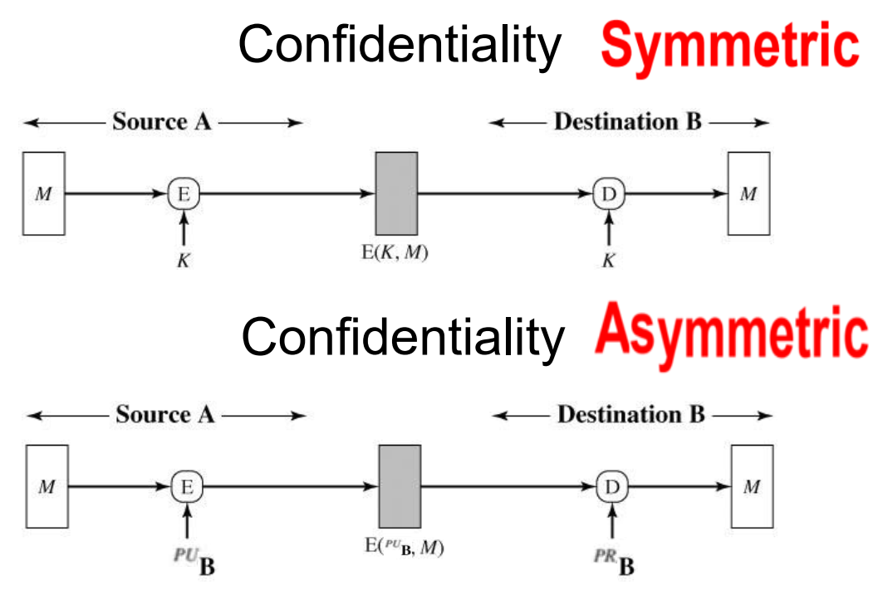
Use case
prevents unauthorized access to sensitive information.

Slide 8
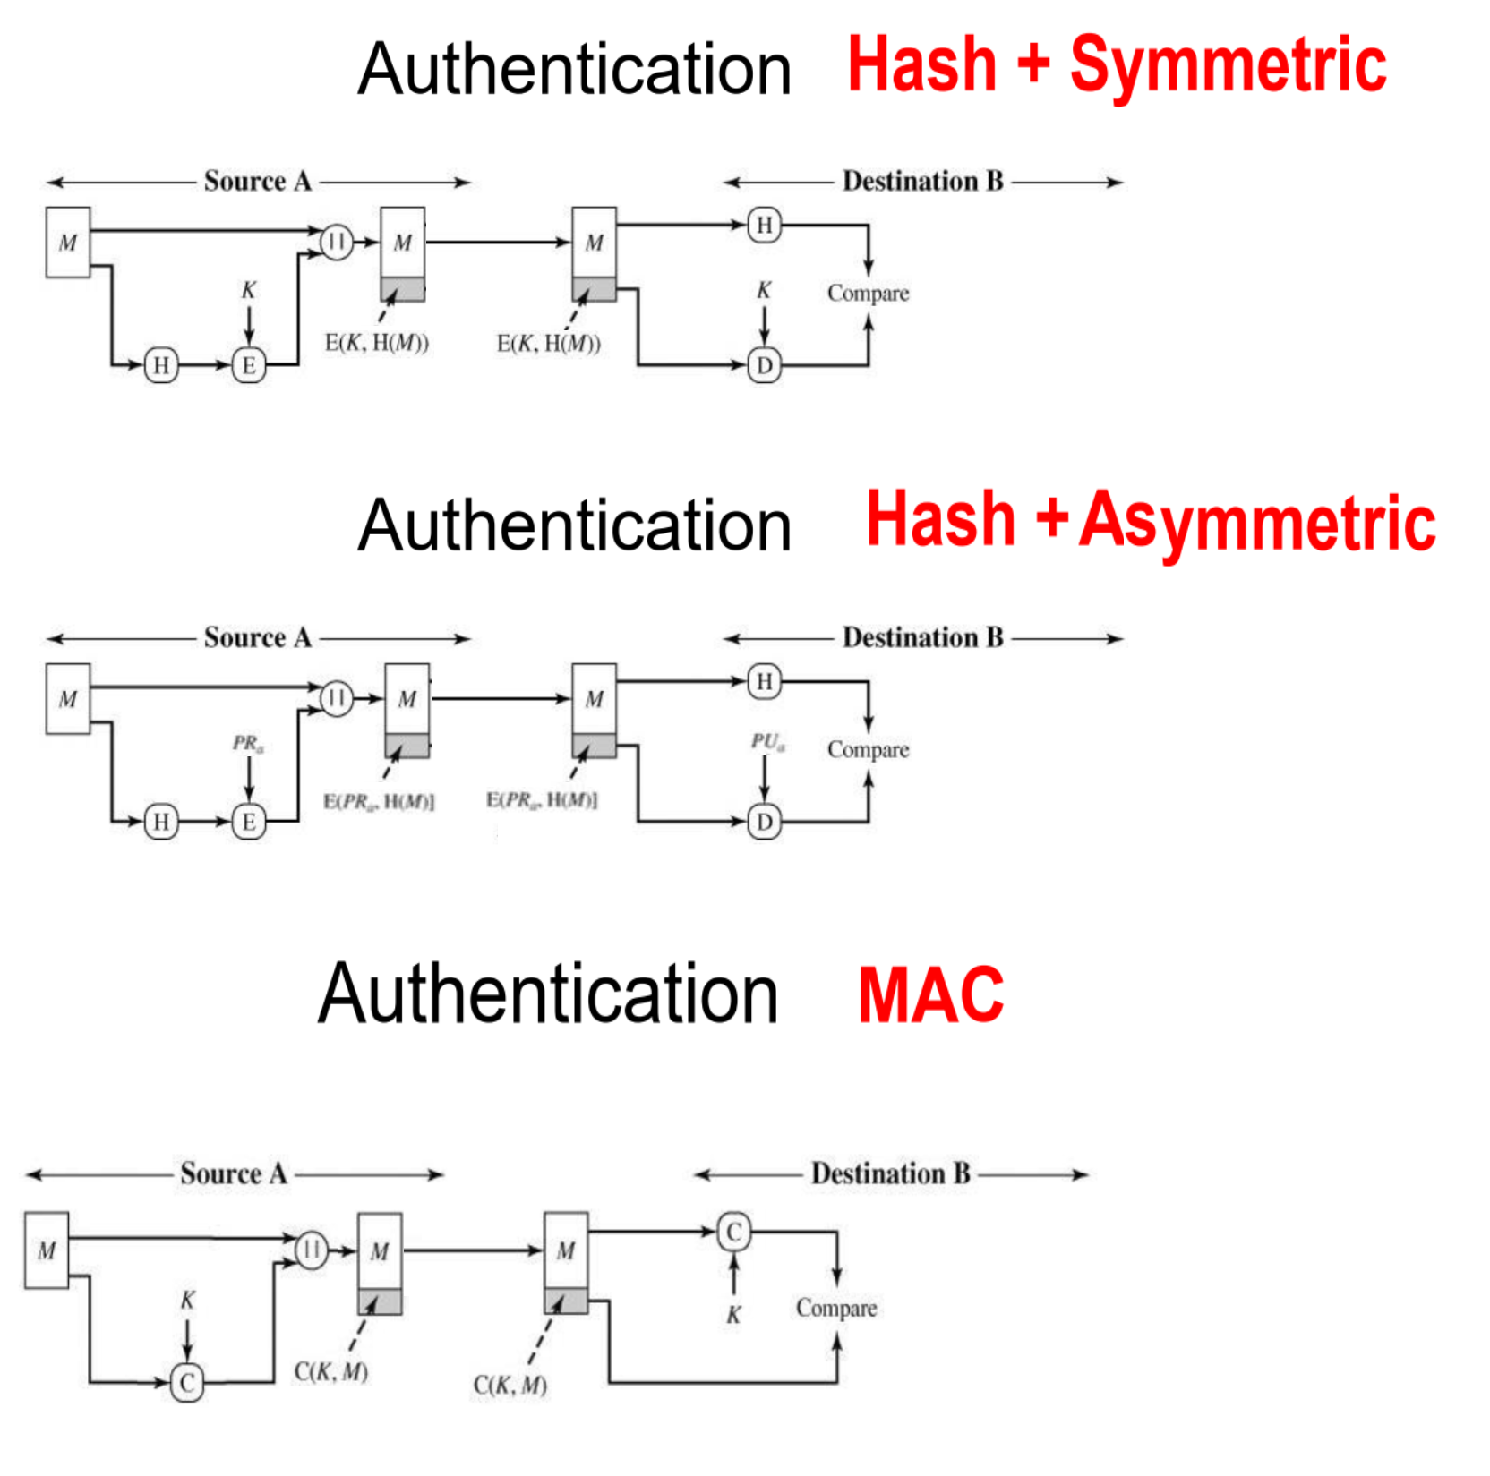
Use case at which we recommend authentication over encryption of plaintext
plaintext is large book
I want to ensure that no one edit it during transmission.
it is okay if anyone could read it

Slide 9
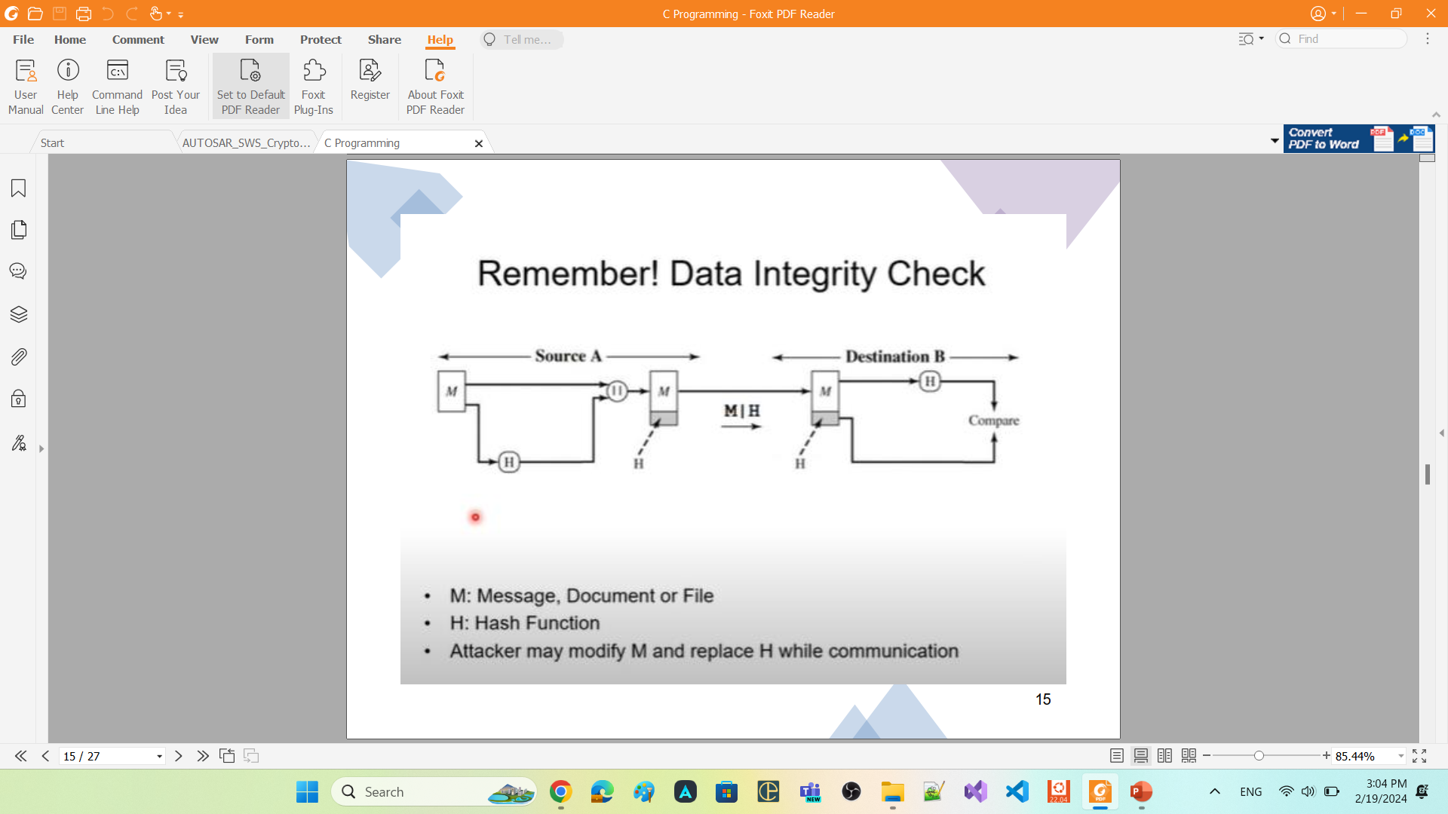
Use case
When we want to store data in the memory, and we want to sure that no one have modify this data

Slide 10
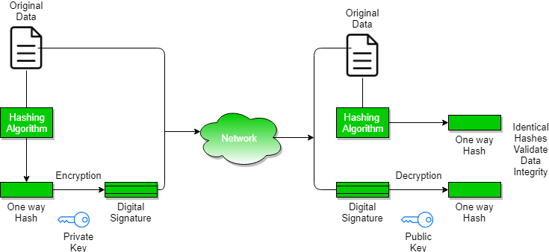
Digital Signature

Slide 11
FC Crypto

Slide 12
FC Crypto
foundation functional cluster.
offers applications and other Adaptive AUTOSAR Functional Cluster a standardized interface (CryptoAPI) for
access multiple implementations of cryptographic operations
key management
certificate handling.
supports
symmetric-key cryptography.
both public-key cryptography
CryptoAPI provides a set of methods which enable application and system developer to
store and transmit information while safeguarding it from intruders.
keep critical information in confidential and / or authentic form
communicate in a way such that only the intended recipient can read the message
FC Crypto
provides mechanisms for applications that ensure the following security goals:
Authentication: FC Crypto provides mechanisms that allow adaptive applications or functional clusters to prove their identity to other applications or functional clusters.
Confidentiality: FC Crypto allows to keep information private. encryption can assure that only users who have access to the appropriate key will get read access to the data plaintext.
Integrity: FC Crypto ensures that secured data is not altered during storage or transmission without the receiver detecting this altering

Slide 13
The FC Crypto
mediates for Adaptive Application and Functional Cluster access and usage of secret key material
The Adaptive Application and Functional Cluster should not have direct access to keys within its own process.
verifies whether an application or functional cluster is allowed to access a specific cryptographic object, which is stored in the infrastructure of the FC Crypto.
This access control mechanism is realized in combination with IAM, where the FC Crypto acts as a policy enforcement point.

Slide 14
Crypto API

Slide 15
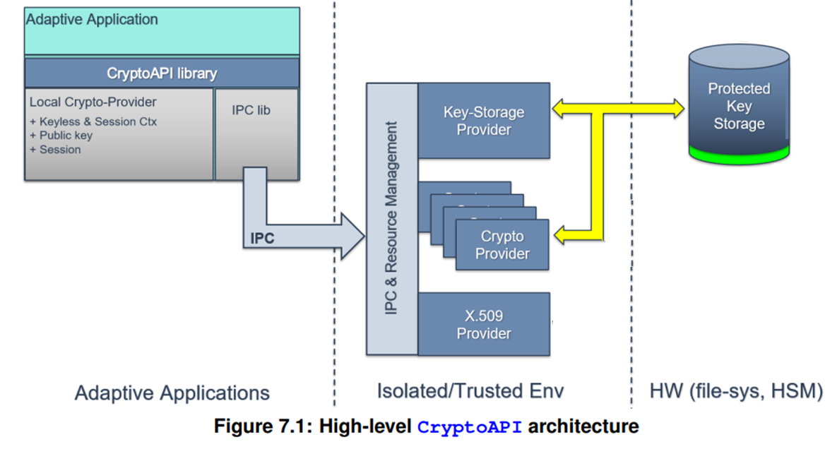
Crypto API is divided into the following sub-parts:
Key Storage Provider.
One or more Crypto Provider
X.509 Certificate Management
Provider
each of provider implements specific domain
of cryptography-related functionality

Slide 16
CryptoAPI provided by FC Crypto to consumers is presented by three different Provider types, each of them implements specific domain of cryptography-related functionality:
1. CryptoProvider (CP, namespace ara::crypto::cryp)
responsible for implementation of all supported cryptographic primitives.
FC Crypto may support multiple instances of the CryptoProviders.
Each instance of CryptoProvider represents single holistic software- or hardware-based implementation of some set of cryptographic algorithms.
2. Key Storage Provider (KSP, namespace ara::crypto::keys)
responsible for secure (confidential and/or authentic) storage of different type key material (public/private/secret keys, seeds) and other security critical cryptographic objects (digital signatures, hash, MAC/HMAC tags).
CryptoAPI consumers work with logically single KSP that is used for access to all crypto objects

Slide 17
Crypto Provider

Slide 18

FC Crypto allow to use software libraries like
Crypto++
Openssl
Mbedtls
…
Crypto Provider standardize the APIs that should be use to preform cryptographic operations
Crypto Provider is a structural element that organizes cryptographic primitives (algorithms).
Every Crypto Provider instance represents exactly a cryptographic library.
at least one Crypto Provider for software element that is available in a project specific environment

Slide 19



Crypto Provider class == CrpytoProviderFactory
doesn't have constructor inside its public scope
Any instance of it can be used to preform cryptographic operations
CyptoPP_CryptoProvider or OpenSLL_CryptoProvider or Mbedtls_CryptoProvider also doesnot have constructor inside their public scope
CryptoProvider
CyptoPP_CryptoProvider
OpenSLL_CryptoProvider
Mbedtls_CryptoProvider

Slide 20
Crypto Object

Slide 21


Slide 22
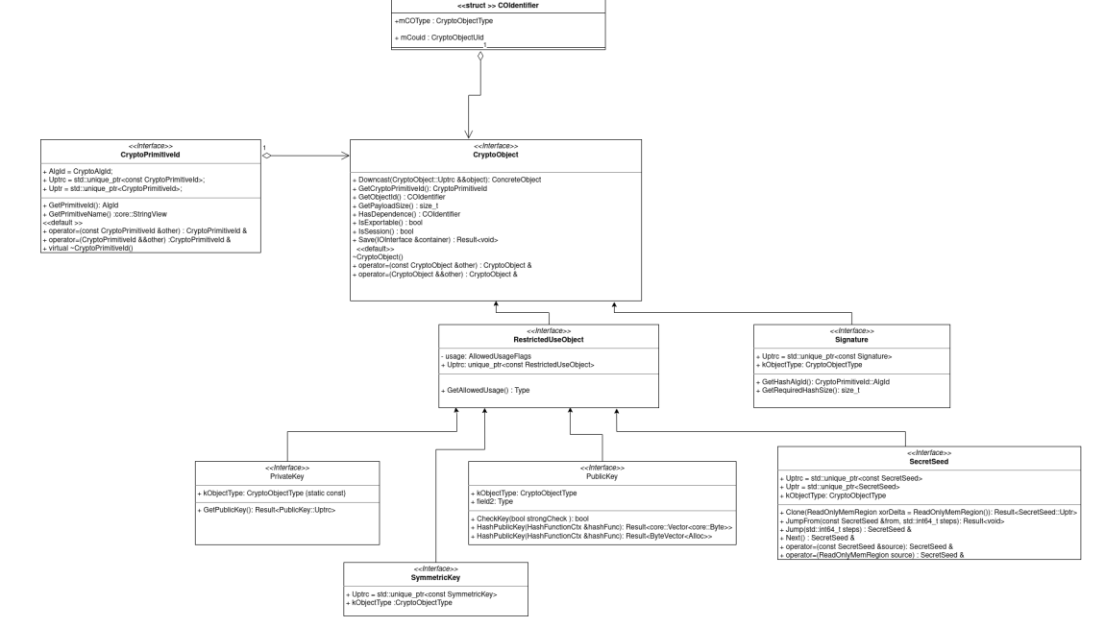

Slide 23



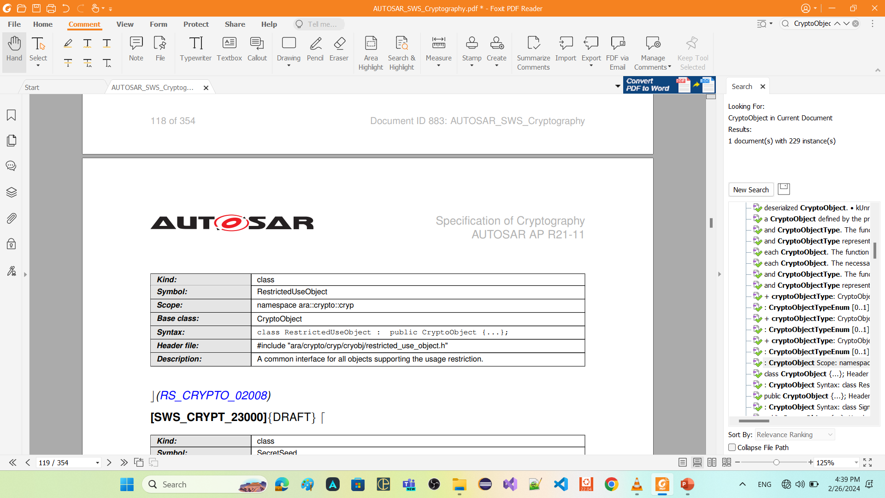
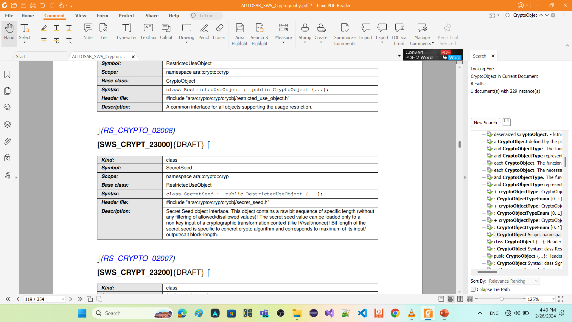
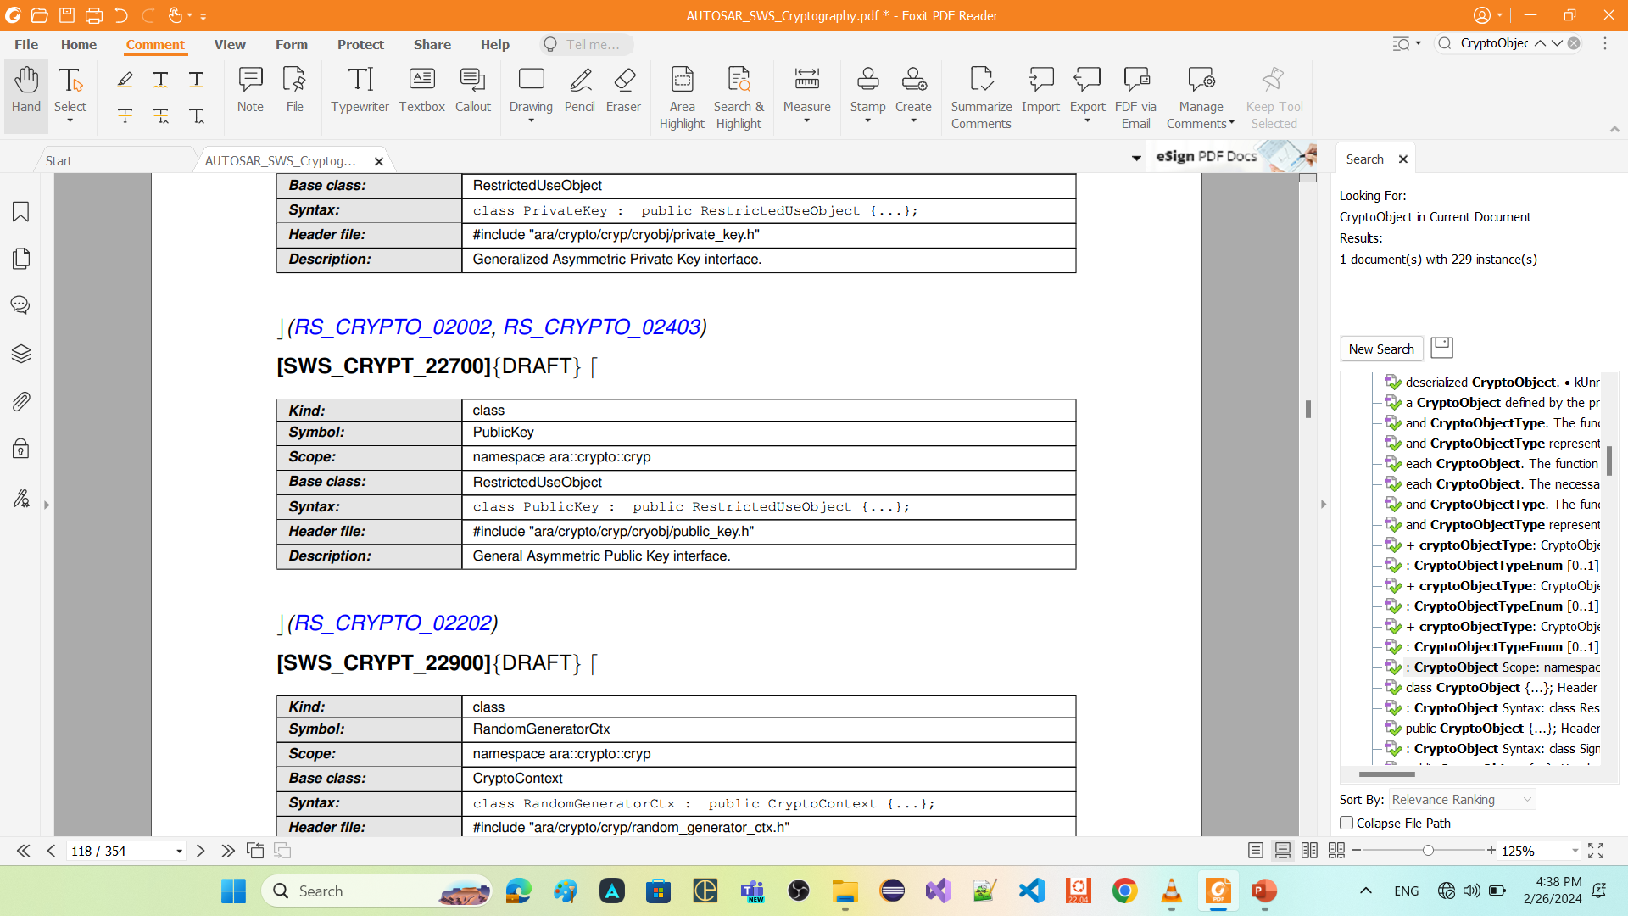
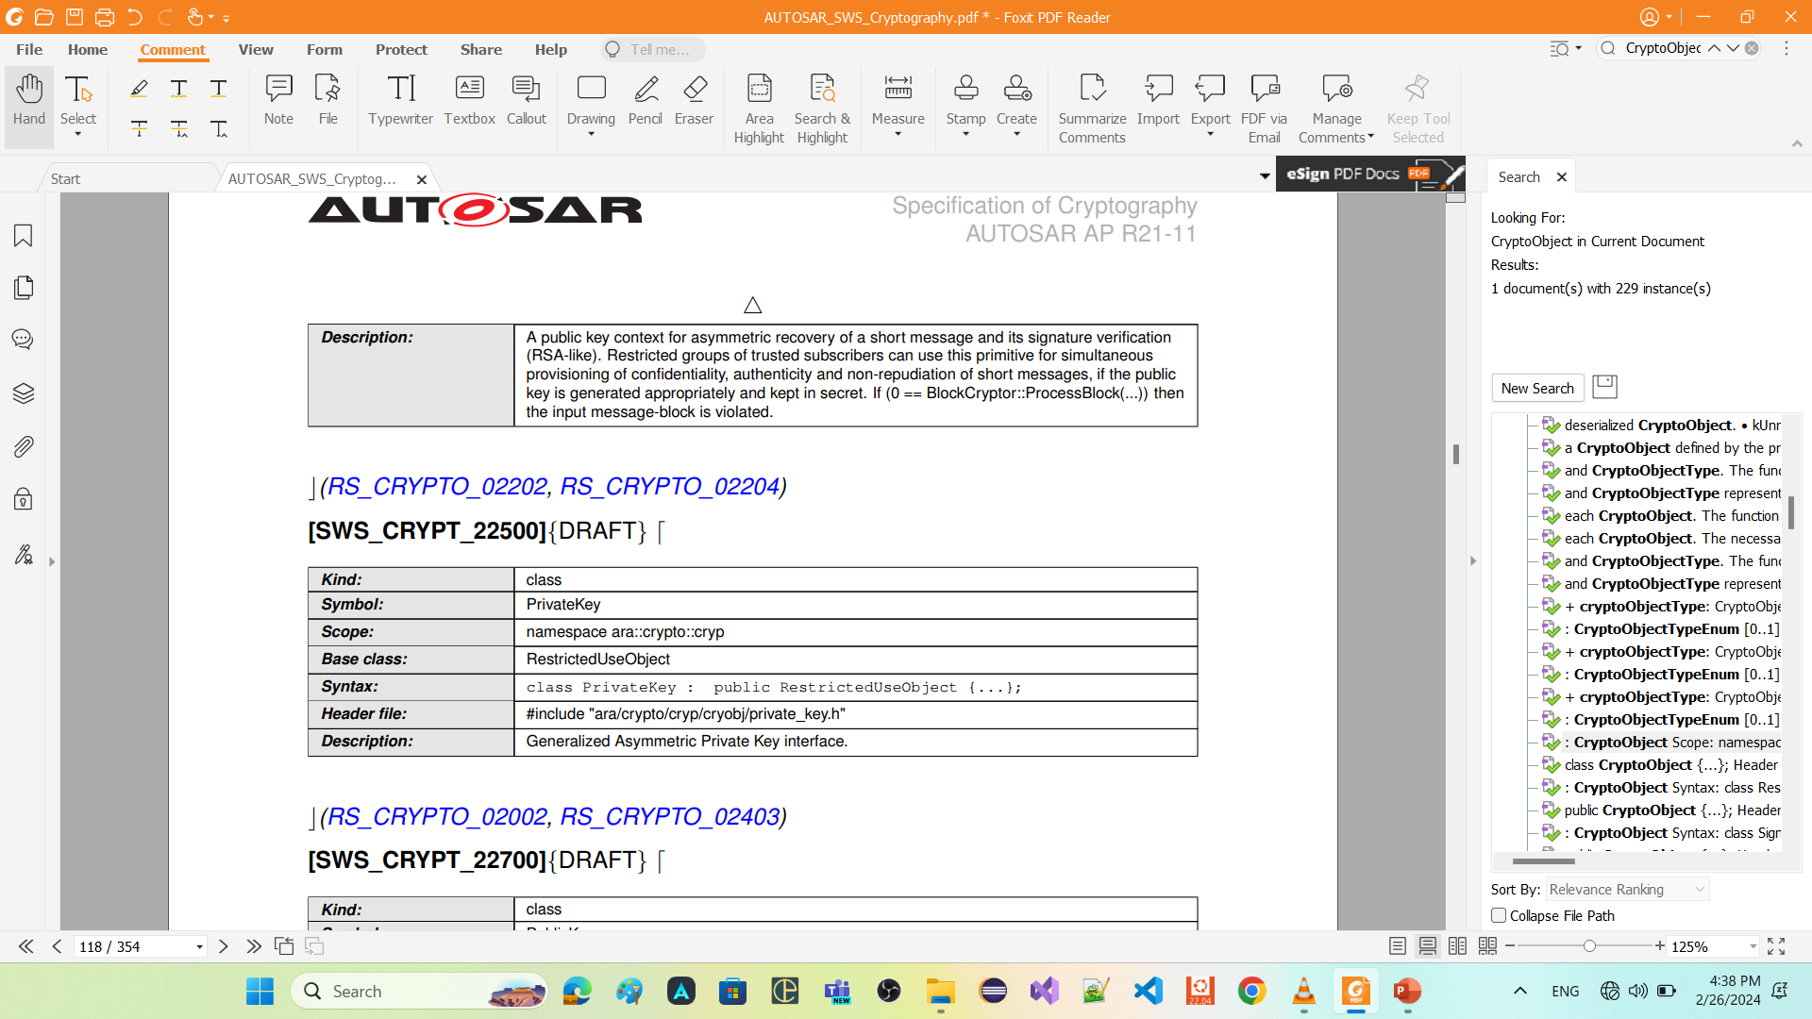












Slide 24
entry_point

Slide 25
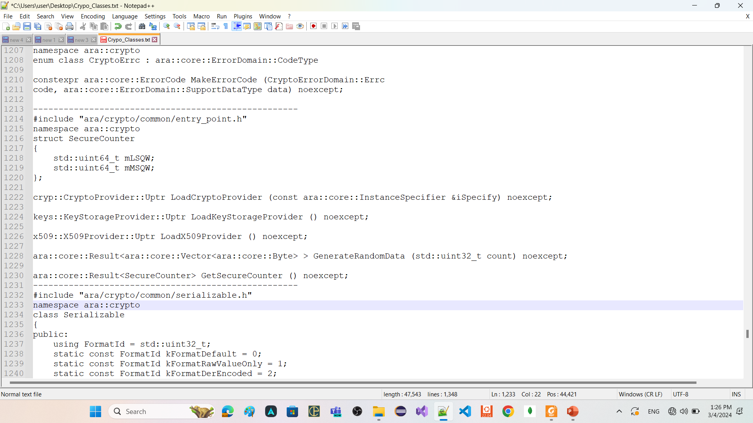

Slide 26
contexts

Slide 27
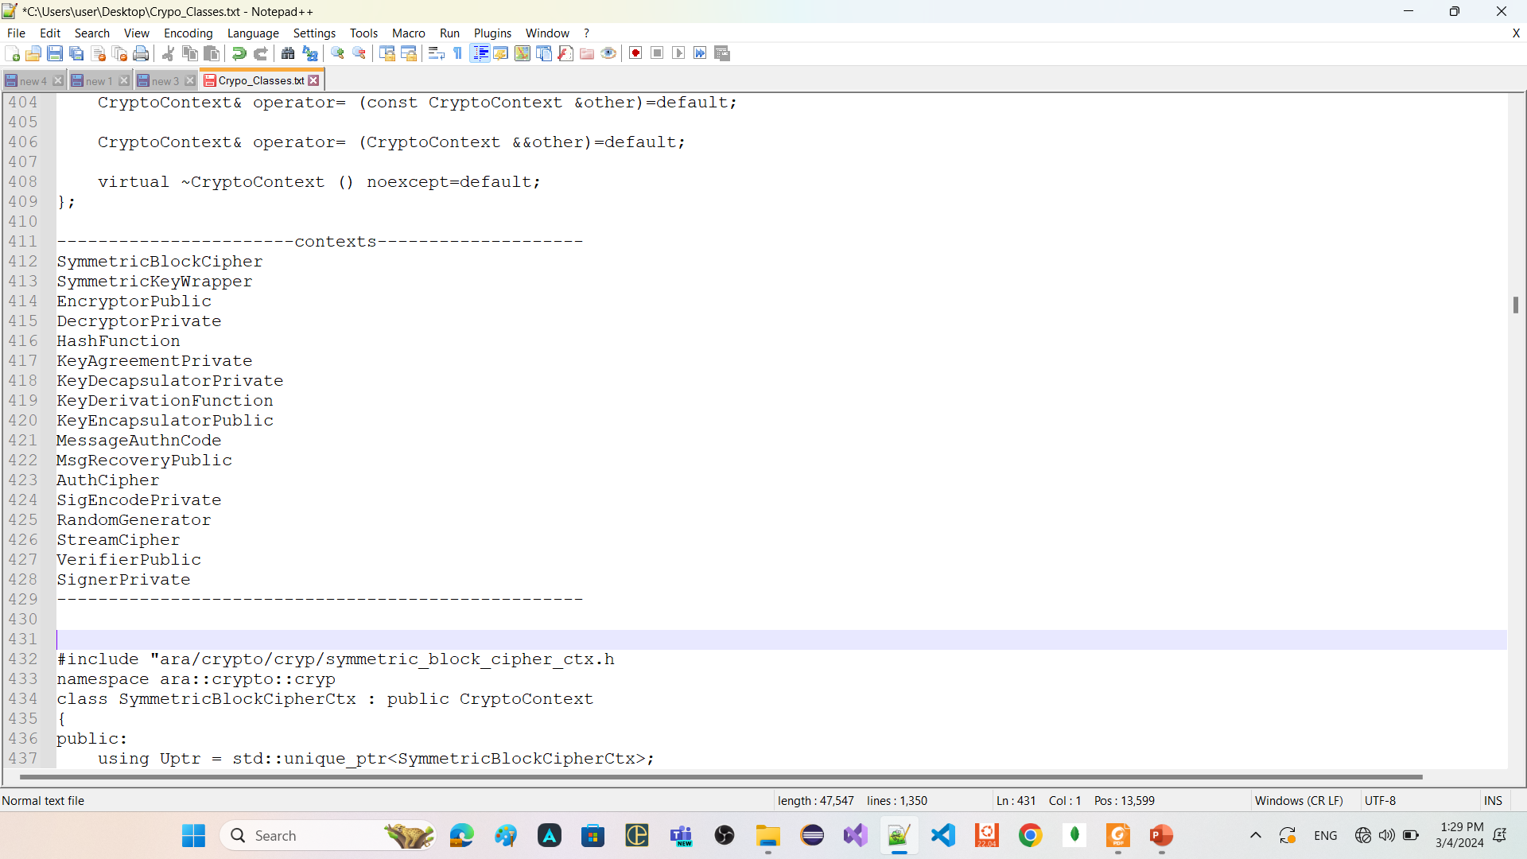
context refers to a data structure or object that encapsulates the state and parameters required for a specific cryptographic operation.

Slide 28
Key1
Key2
DES
AES
RSA
ECDSA
Key3
Key4
Sha-256
context
Sha-512
context
DES
Sha-3
context
context
AES
RSA
context
context
Sha-256
CryptoProvider

Slide 29
SymmetricBlockCipherCtx
implement symmetric block cipher algorithms

Slide 30
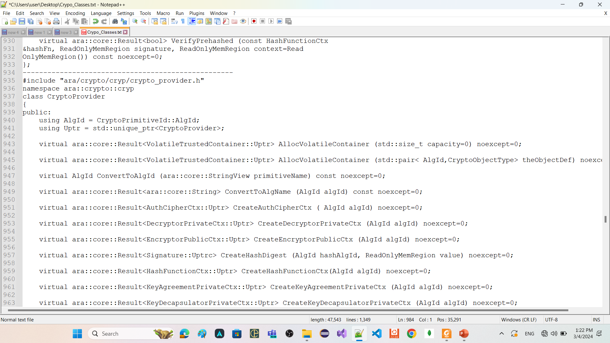
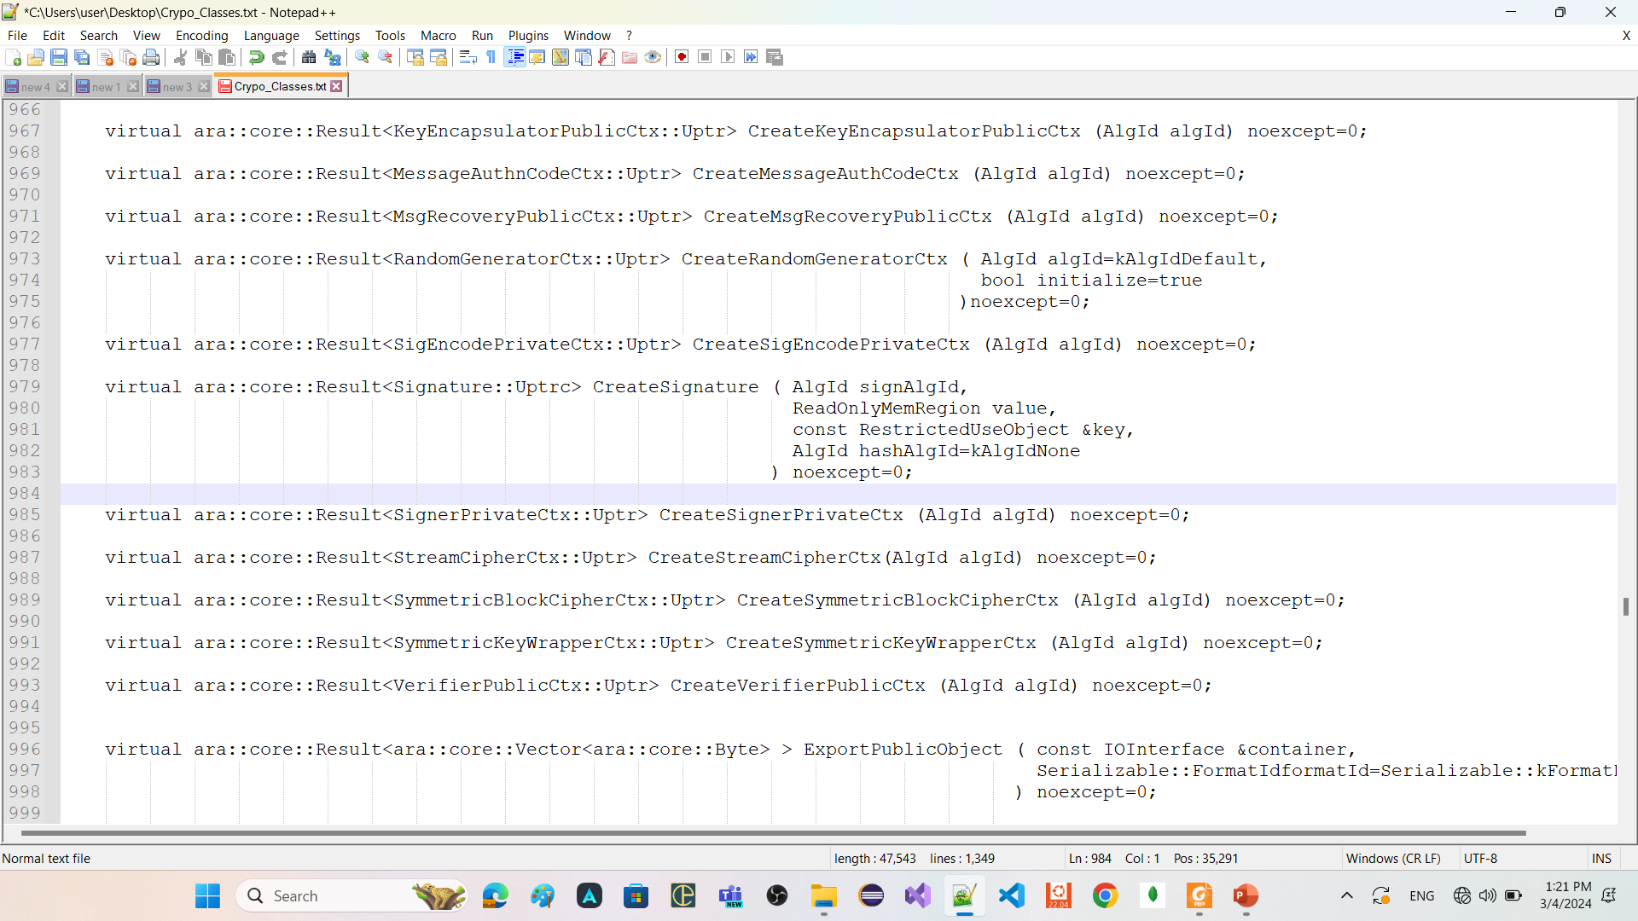
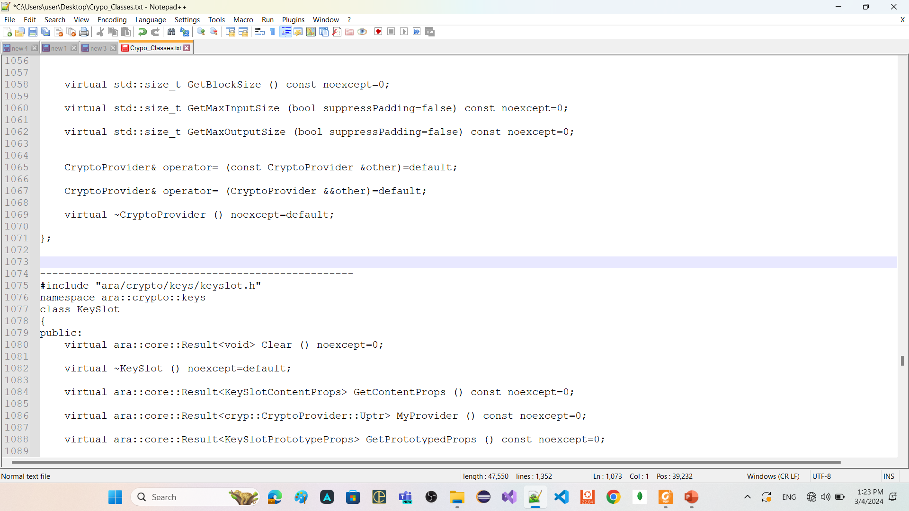


Slide 31


Slide 32
SymmetricBlockCipherCtx
Its object related only one algorithm of Symmetric block cipher algorithms
has member functions
SetKey
Takes object of class CryptoTransform
To configure this context is for encryption or decryption
Takes object of class SymmetricKey
GetTransformation
return the CryptoTransform that was provided in the last valid call to SetKey.
GetCryptoService
return a unique pointer to CryptoService associated with this context.
ProcessBlock
apply the configured transformation (encryption or decryption) to the provided ReadOnlyMemRegion (container of elements) (span) and return the result.

Slide 33


Slide 34
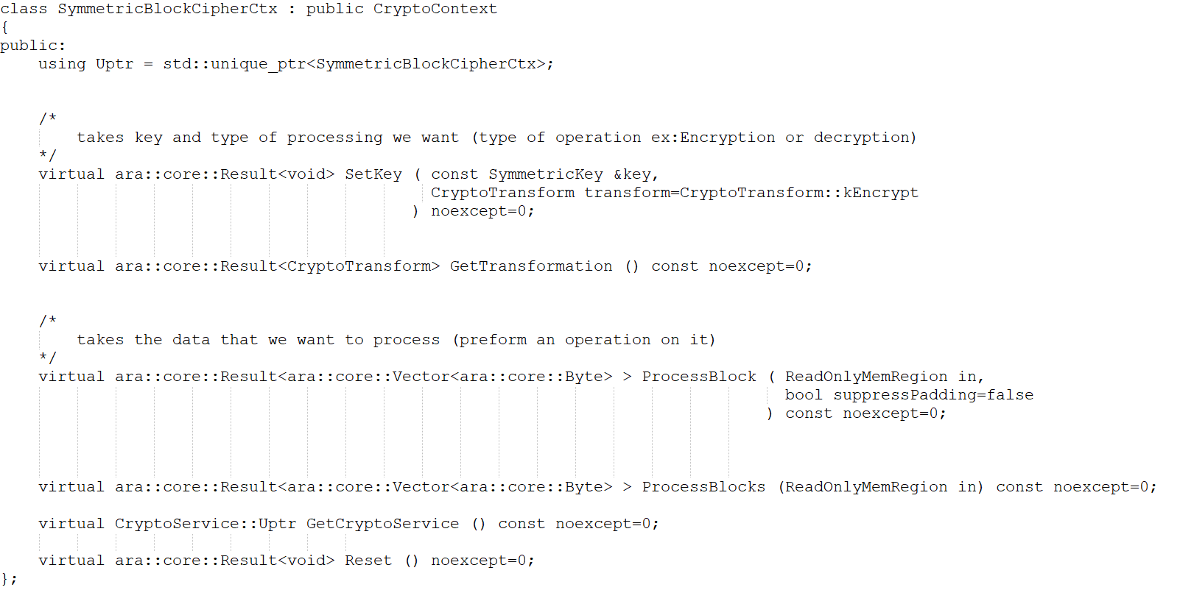

Slide 35

































Slide 36
HashFunctionCtx
implement hashing algorithms

Slide 37
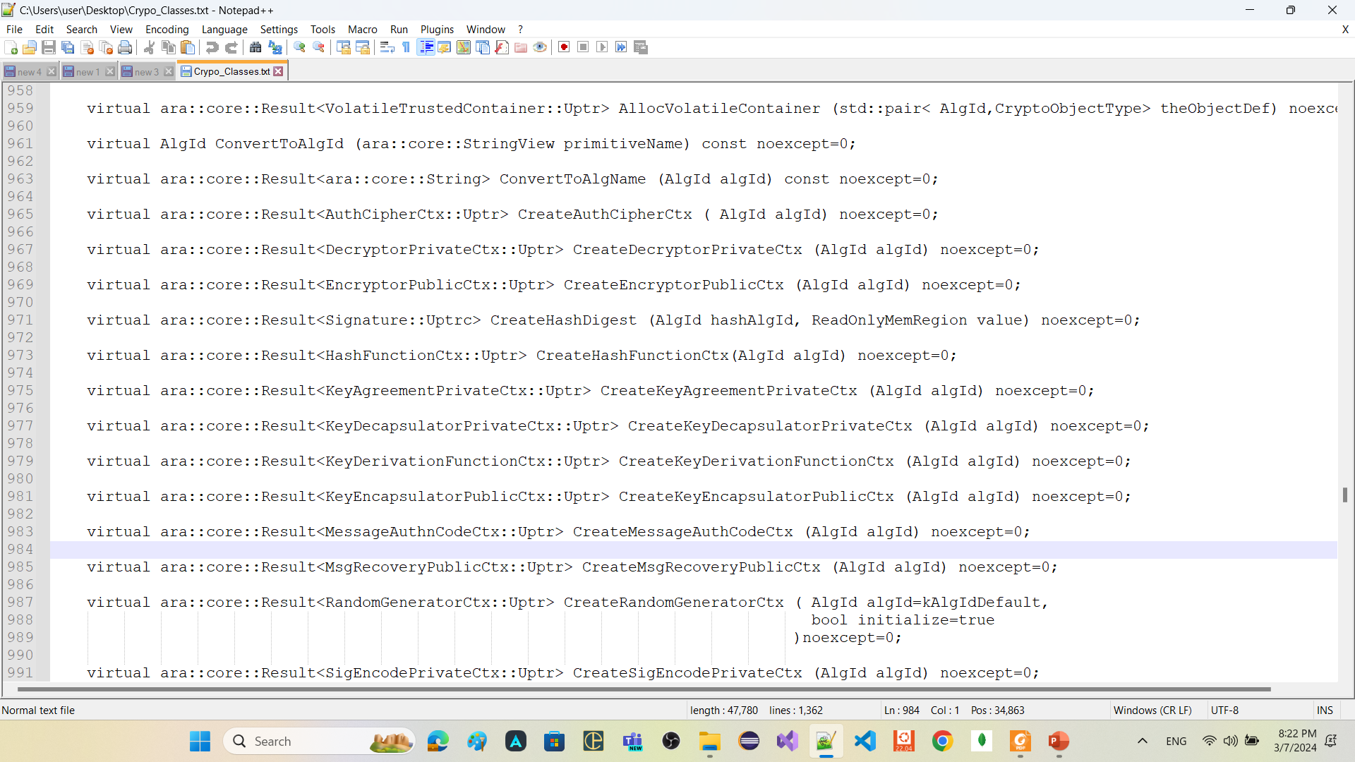
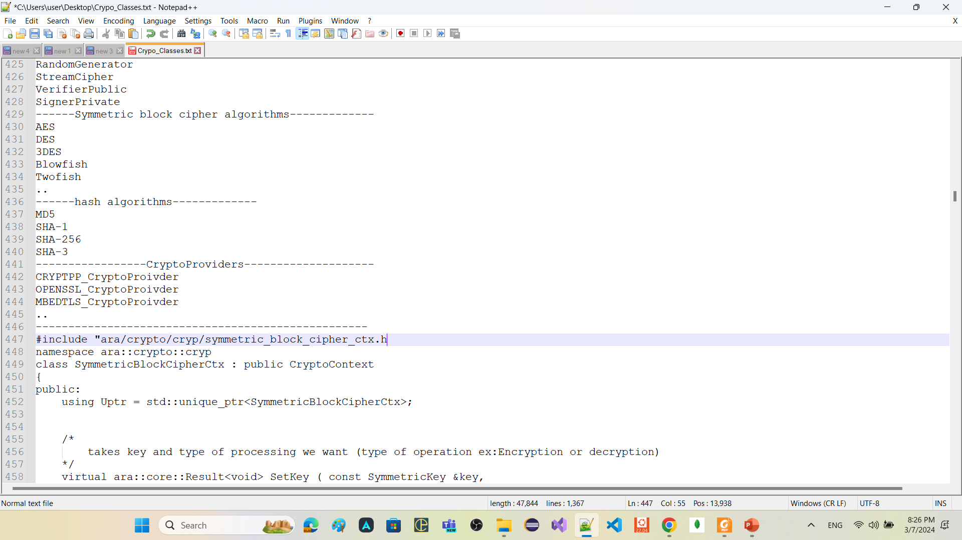

Slide 38
Remember
A hash-function a one-way function and maps an arbitrary string of bits to a fixedlength string of bits (Its result is practical infeasible to invert).
HashFunctionCtx
Its object is related only one algorithm of hashing algorithms
store the calculated hash value until this HashFunctionCtx object is destroyed or the function Start is called again.
has member functions
Start
Functionality
clear the current hash value and initialize the context with the provided IV
prototype
ara::core::Result<void> Start ();
ara::core::Result<void> Start (ReadOnlyMemRegion iv);
returns
kInvalidInputSize, if the size of the provided IV is not supported by the configured context AlgId.
kUnsupported, If the configured context AlgId does not support an IV.
kMissingArgument, if the configured context AlgId expected an IV but none was provided
Notes
Start can be called after Update. In this case the HashFunctionCtx will not return an error, instead Start will start a new hash value calculation.

Slide 39
Update
Functionality
implement hash algorithm calculation.
Prototype
ara::core::Result<void> Update (ReadOnlyMemRegion in);
returns
CryptoErrorDomain::kProcessingNotStarted error, if Start has not been called before
Notes
The user application shall be able to call Update multiple times, each time providing a new chunk of data. Update shall update the hash value calculation with each new chunk.
Finish
Functionality
finalize the hash value calculation and return the hash value
prototype
virtual ara::core::Result<ara::core::Vector<ara::core::Byte> > Finish () noexcept=0;
returns
CryptoErrorDomain::kProcessingNotStarted error, if Start has not been successfully called before.
CryptoErrorDomain::kInvalidUsageOrder error, if Update has not been called successfully after the last call to Start.
Notes
If Finish is called multiple times for the same hash value calculation, then only the first call shall apply the finalizations step; i.e. all other subsequent calls shall only return the hash value.

Slide 40

getDigest
Functionality
return the finalized hash value
Prototype
ara::core::Result<ara::core::Vector<ara::core::Byte> > GetDigest (std::size_t offset=0);
returns
kProcessingNotStarted error, if Finish has not been called for the current hash value calculation
Start
Update
Finish
getDigest

Slide 41
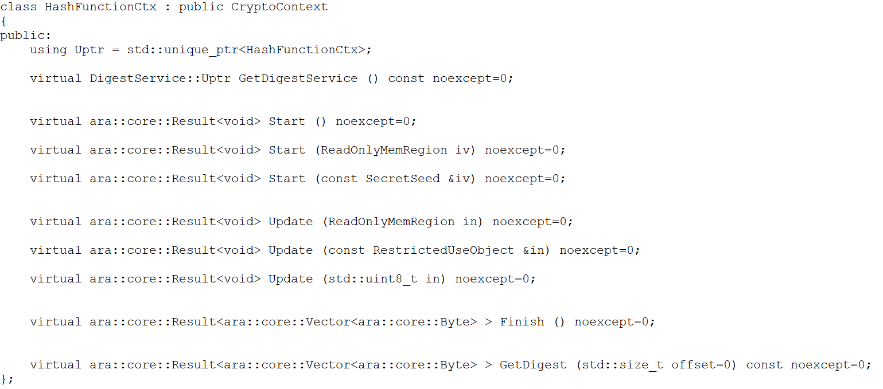

Slide 42
Examples

Slide 43
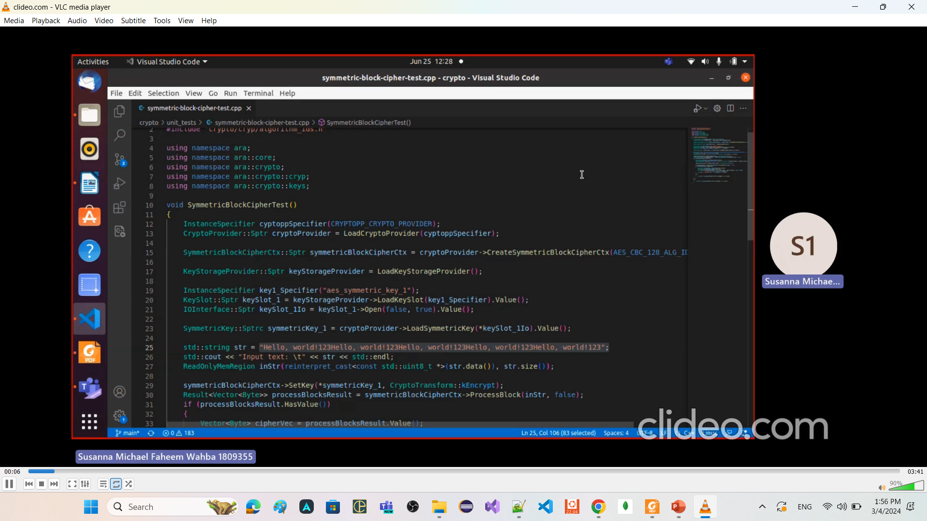
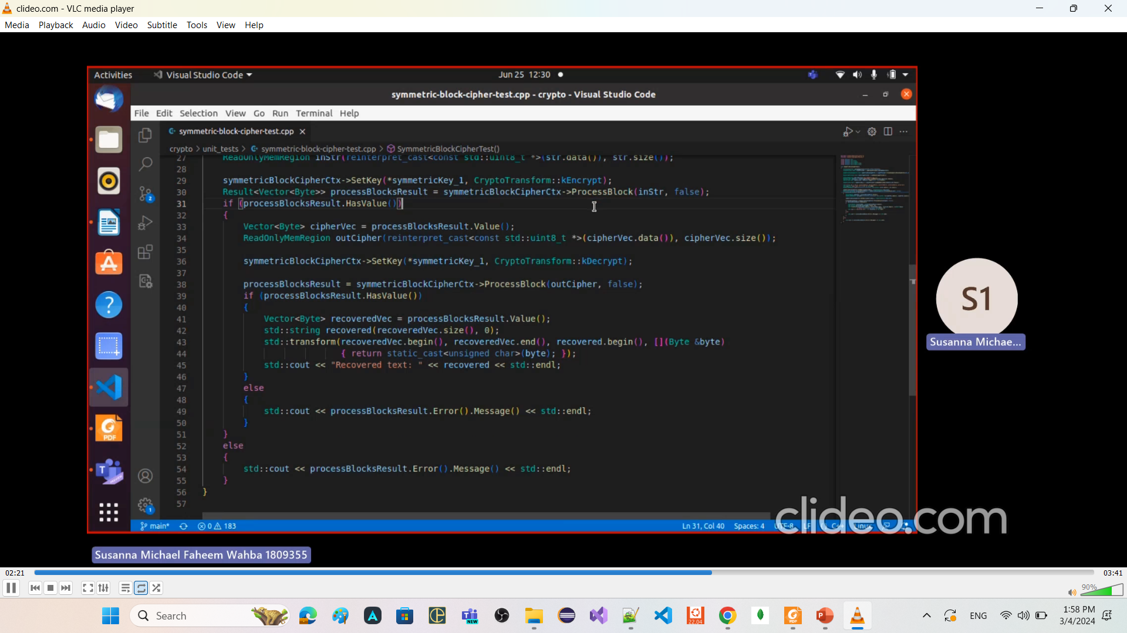
Symmetric Encryption and decryption

Slide 44
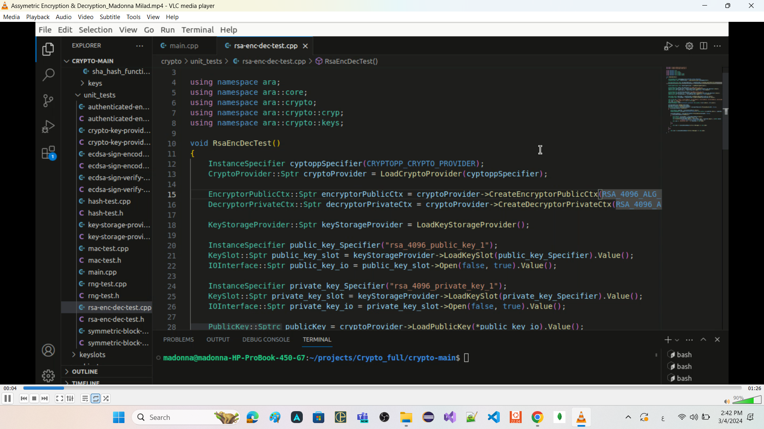
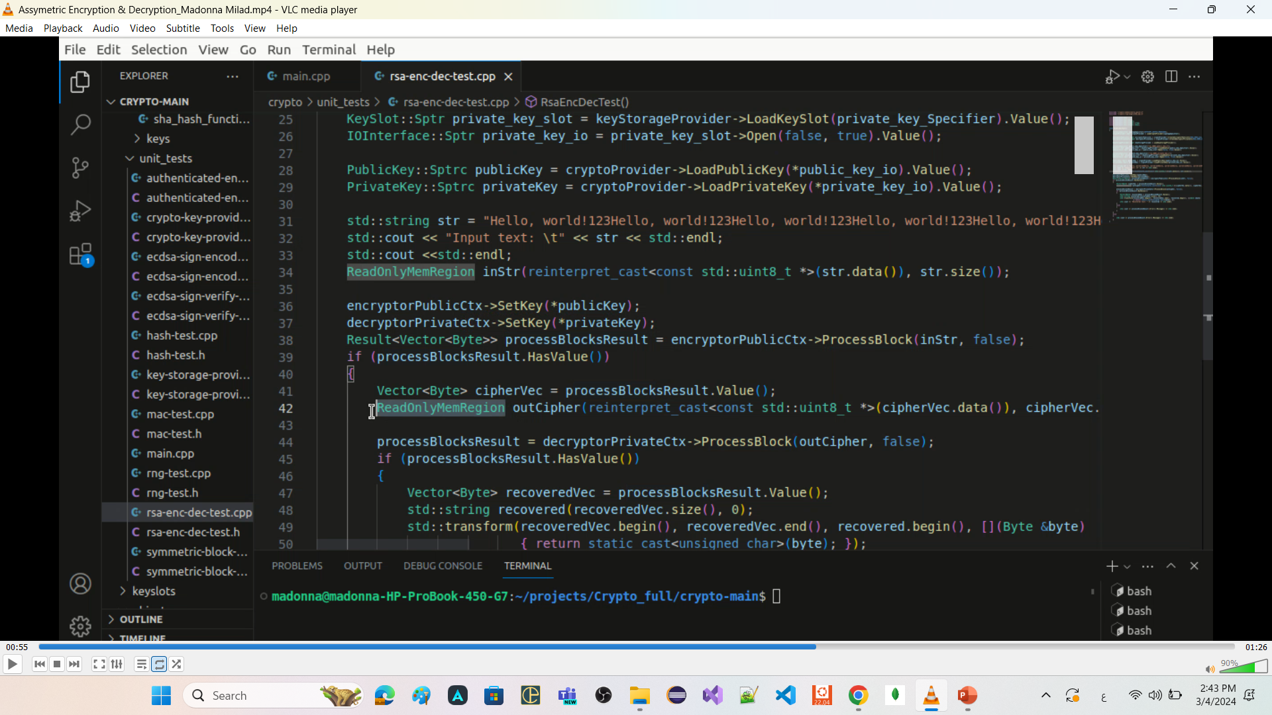
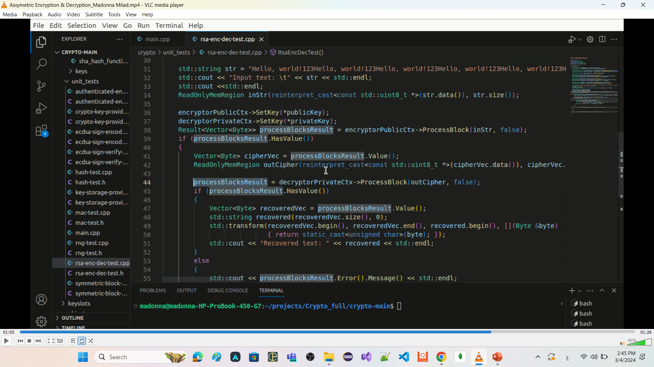
Asymmetric Encryption and decryption

Slide 45
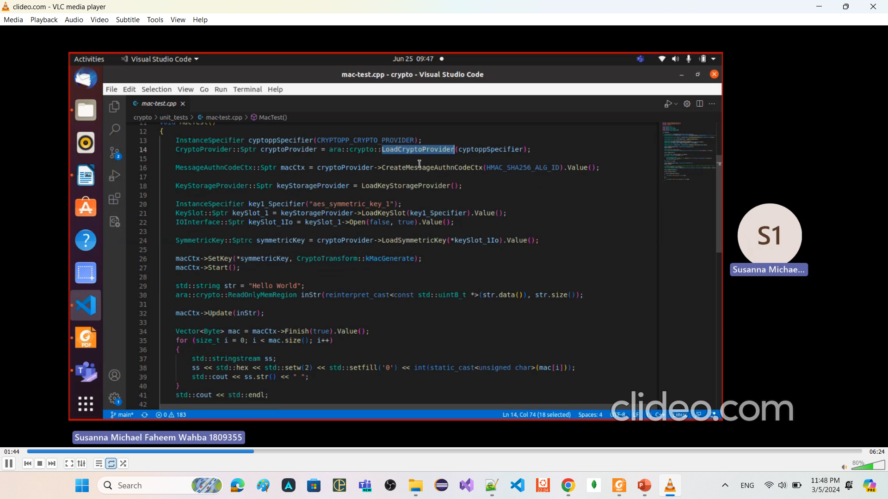
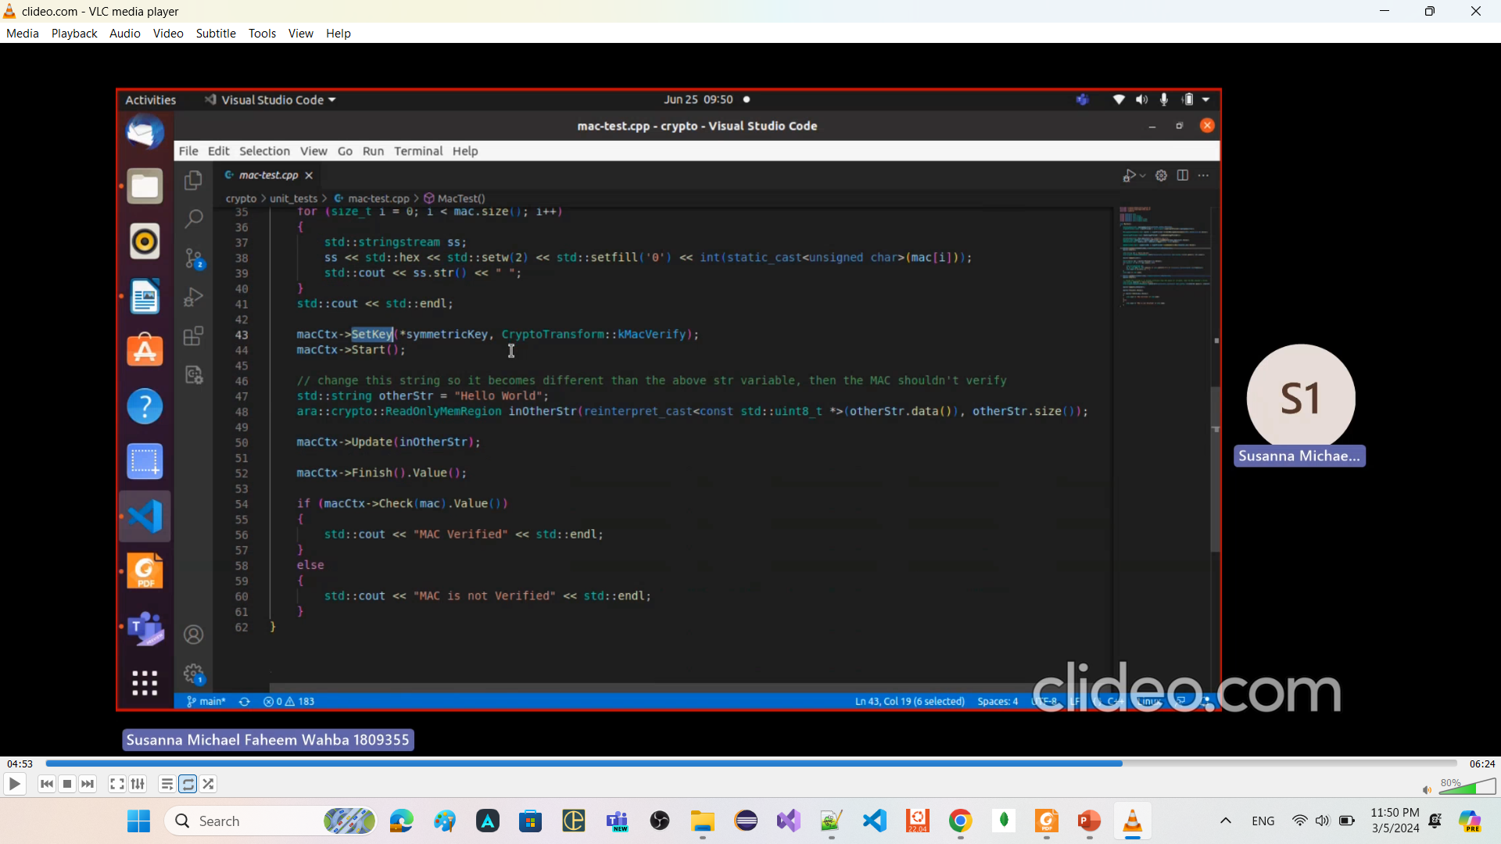
Message authentication
Using HMAC_SHA256

Slide 46
Symmetric Encryption and decryption
------------------------------------------
CreateSymmetricBlockCipherCtx
LoadSymmetricKey
------------------------------------------
Asymmetric Encryption and decryption
---------------------------------------
CreateEncryptorPublicCtx
CreateDecryptorPrivateCtx
LoadPublicKey
LoadPrivateKey
----------------------------------------

Slide 47
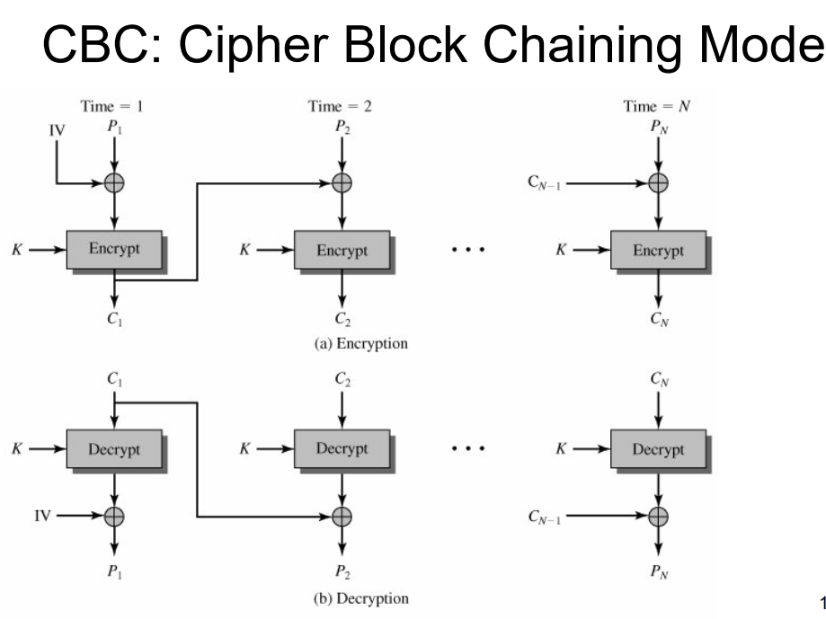
the initialization vector (IV) is not commonly used in the context of hashing algorithms like SHA256, it is commonly used in other cryptographic operations, such as symmetric encryption algorithms like AES (Advanced Encryption Standard) in CBC (Cipher Block Chaining) mode.
In CBC mode, each plaintext block is first XORed with the previous ciphertext block before encryption. To ensure the uniqueness and randomness of the XOR operation, an IV is used as the previous ciphertext block for the first block. The IV is typically a random or pseudorandom value that is known to both the sender and the receiver.
Here's an example of how an IV can be used in hashing when combined with a symmetric encryption algorithm like AES in CBC mode:

Slide 48
Needed Core Classes

Slide 49
std::span
a C++20 class template that provides a view over a contiguous sequence of elements.
"view" refers to a lightweight object that provides a way to look at or access elements of a data structure
without owning the data itself.
without making a copy of the data
particularly useful for passing
array or sub-array
std::array or sub-std::array
std::vector or sub-std::vector
to functions without the need for copying.

